Slide 1
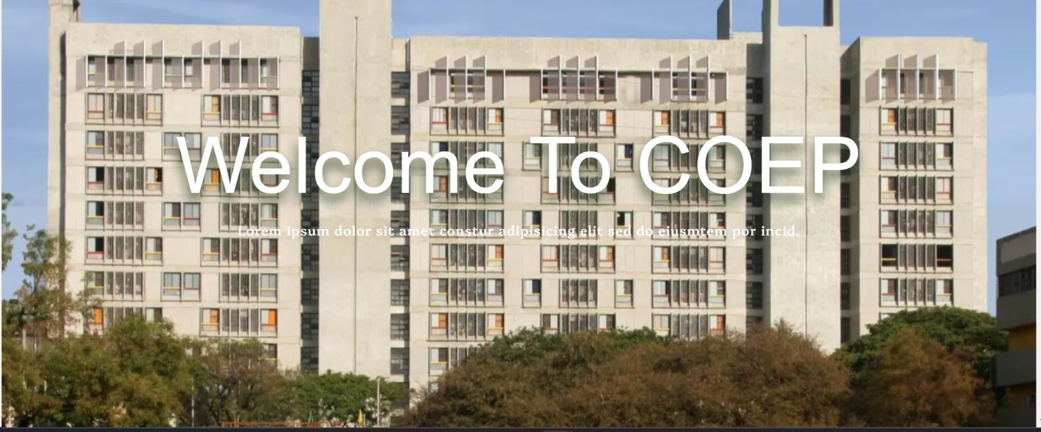

COEP TECH HACKATHON
TEAM – PIRATES
Project title:- Hostel Management System
COEP Technological University
A Unitary Public University of Govt. of Maharashtra
Formerly College of Engineering Pune

Slide 2
Hostel Management
System
Hostel allocation system
Mess management
Laundry
Guestroom Booking
Inventory
Clinic
COEP Technological University
A Unitary Public University of Govt. of Maharashtra
Formerly College of Engineering Pune

Slide 3
Hostel Allocation System
User | Admin
send request to roommates/choose roommates given give preferences of rooms(created UI for that) | He Can generate list of selected student for hostel Allocate rooms based on preferences.
COEP Technological University
A Unitary Public University of Govt. of Maharashtra
Formerly College of Engineering Pune

Slide 4
Mess Management
Laundry
User | Mess Admin
Display menu for each day apply for leave can see his mess bill | change menu on any day generate mess bills He can see total number of students coming to mess and also He can see total number of leaves.
User | Admin
can see availability | Administrators can see who booked a slot and when.
COEP Technological University
A Unitary Public University of Govt. of Maharashtra
Formerly College of Engineering Pune

Slide 5
Guest-Room Booking:
Inventory Management
User | Admin
can select room based on availability and required capacity | He can Accept or Reject booking.
after sending request for room booking he gets mail when admin accepts it. | Can see total revenue in pie chart form
he can make payments from link
User | Admin
can see Products | Add Product
 | delete product
 | Update product
COEP Technological University
A Unitary Public University of Govt. of Maharashtra
Formerly College of Engineering Pune

Slide 6
Future Scope:
We can Deploy the Project.
Can be implemented in other hostel as well.
COEP Technological University
A Unitary Public University of Govt. of Maharashtra
Formerly College of Engineering Pune

